Slide 1
Information-Theoretic Models
(10.1 ~ 10.5)
Huafu Chen
SLST, UESTC

Slide 2
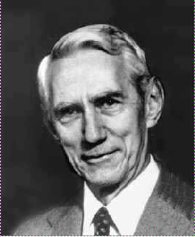
Claude Elwood Shannon 1916.4.30-2001.2.24
Marvin Minsky described Shannon as follows:-
Whatever came up, he engaged it with joy, and he attacked it with some surprising resource which might be some new kind of technical concept or a hammer and saw with some scraps of wood. For him, the harder a problem might seem, the better the chance to find something new.
Notes:
Scrap 碎片 切屑

Slide 3
10.1 Introduction
Information Theory
  Fundamental Information theory
  1948, Claude Shannon’s classic paper for designing communication systems that are both efficient and reliable.
  It provides a framework for the study of fundamental issues such as the efficiency of information representation and limitations involved in the reliable transmission of information over a communication channel.

Slide 4
10.1 Introduction
  Information-Theoretic Model for Self-Organizing Systems
  Maximum mutual information principle (Linsker 1988), it states that the synaptic connections of a multi-layered neural network develop in such a way as to maximize the amount of information that is preserved when signals are transformed at each processing stage of the network, subject to certain constraints.
  An early paper Attneave 1954 about the relation between the information theory and perceptual processing：
  A major function of the perceptual machinery is to strip away some of the redundancy of stimulation, to describe or encode information in a form more economical than that in which it impinges on the receptors.

Slide 5
Fundamentals of information theory
10.2 : Entropy
10.3 Maximum Entropy Principle
10.4 Mutual Information
10.5 Kullback-Leibler Divergence

Slide 6
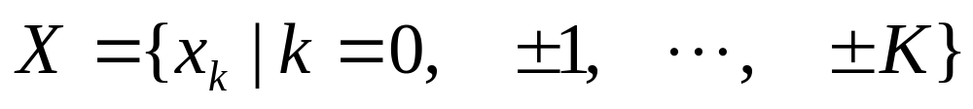

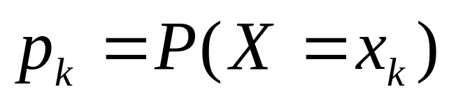
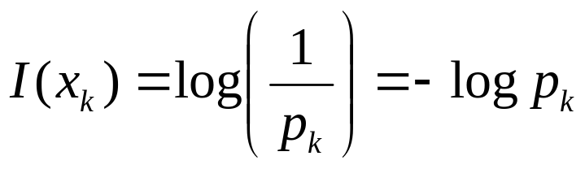
10.2 Entropy
Random Variable
  Discrete random variable
  Event occur with probability
Information
  Uncertainty / Surprise / Information
  Inverse of the probability of occurrence

Slide 7



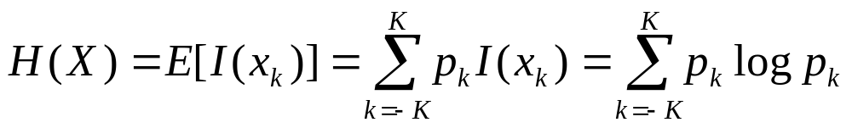

10.2 Entropy
Properties of Information
Entropy of Discrete Random Variable
(Mean value of I(x_{k}) )

Slide 8
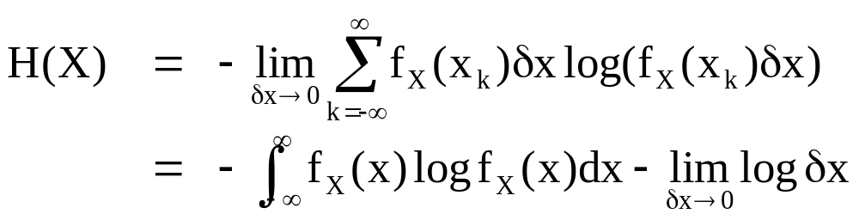
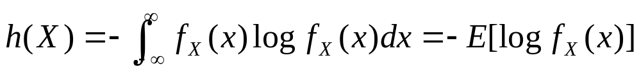


10.2 Entropy
Entropy of Continuous Random Variable ( Eq.(10.13))
Differential Entropy of Continuous Random Variable
  （这里用差分熵，区别于离散情况的 常规熵或绝对熵）
  Properties of differential entropy

Slide 9
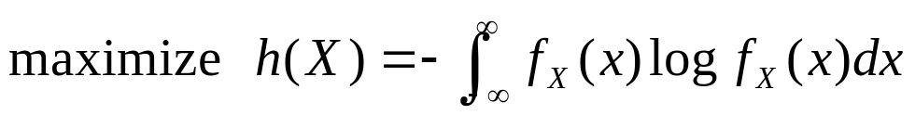

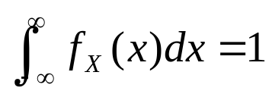
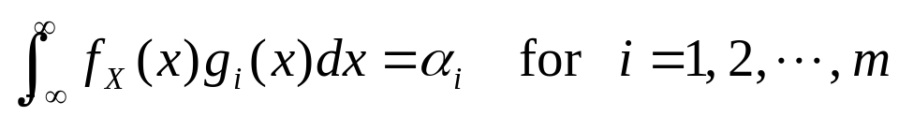
10.3 Maximum Entropy Principle
Maximum Entropy Principle
Maximum Entropy as Constrained Optimization Problem
  When an inference is made on the basis of incomplete information, it should be drawn from the probability distribution that maximizes the entropy, subject to constraints on the distribution.
Subject to the following constraints:
Defines the moments of X depending on g.
Notes:
第3个约束事实上可理解为综合了，随机变量的所有先念信息，包括前一个条件

Slide 10
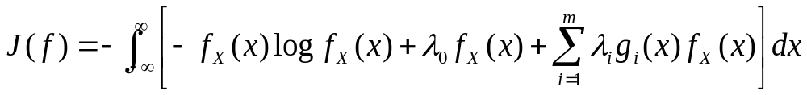

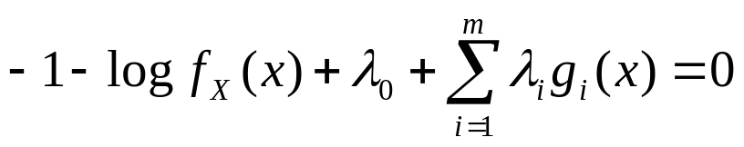
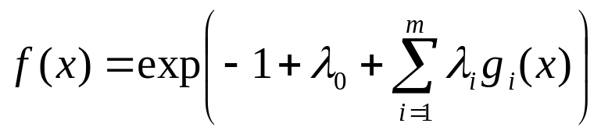
10.3 Maximum Entropy Principle
Solving this constrained optimization problem by Method of Lagrange Multipliers
where are the Lagrange multipliers
Differenting the integrand with respect to f_{X}(x) and then setting the result equal to zero, we get
Which results in
The Lagrange multipliers are chosen in accordance with the above constraints 2 and 3.

Slide 11
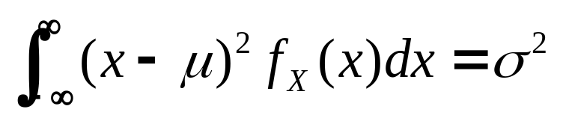
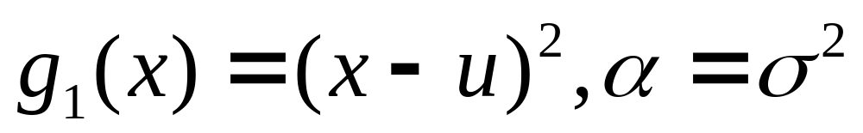
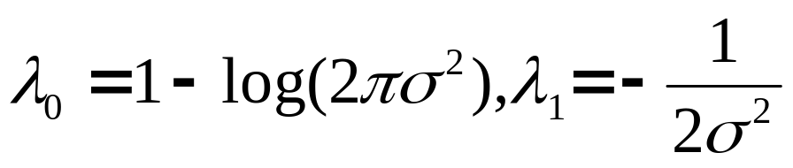
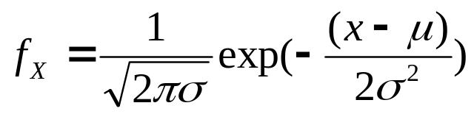
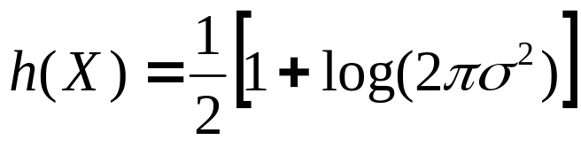
Example 10.2 /page 491
概率密度函数
微分熵

Slide 12
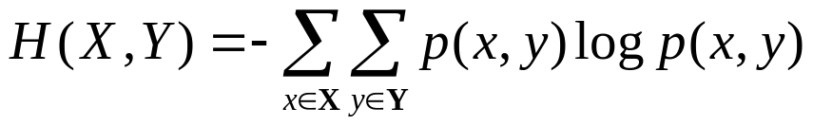


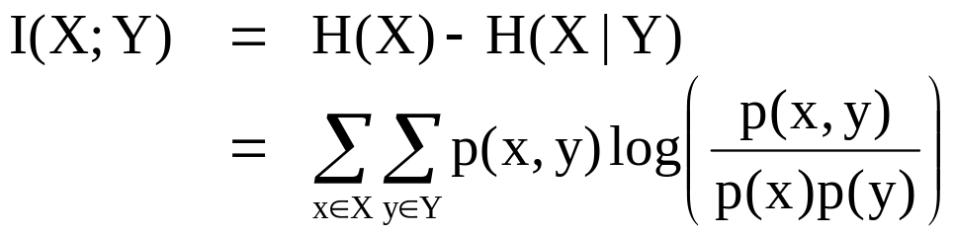
10.4 Mutual Information
Joint entropy of X and Y
Conditional entropy of X given Y
Mutual information
H(x|y) the uncertainty about X after observing Y.
H(x) uncertainty about the system input X before measuring the system output Y.
The difference H(x)-H(x|y) must represent our uncertainty about the system input X that is resolved by observing the system output.
Notes:
熵大，不确定性就大；因此 一旦发生，提供的信息量就大
I(X,Y) 是知道Y后，对X的不确定性有一定量的减少，也就是Y的出现 提供了X的部分原来不确定的东西，这部分减少是互信息量

Slide 13



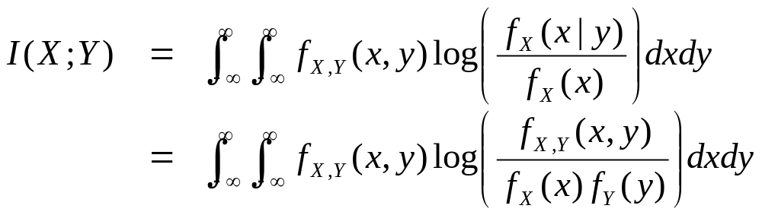
10.4 Mutual Information
Properties of mutual information
Mutual information for continuous random variables

Slide 14
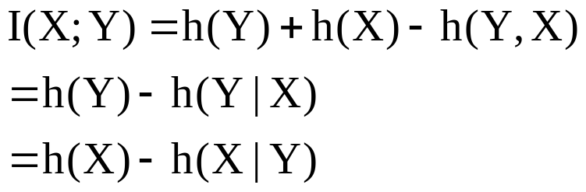
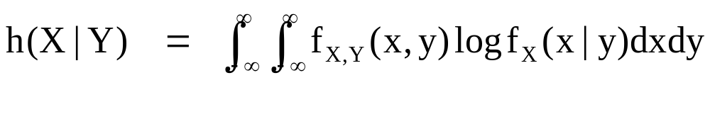

Properties of mutual information
When X and Y are statistically independent which means that f_{X,Y}(x,y)= f_{X}(x) f_{Y} (y), and f_{X}(x|y)= f_{X}(x)

Slide 15
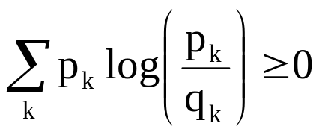
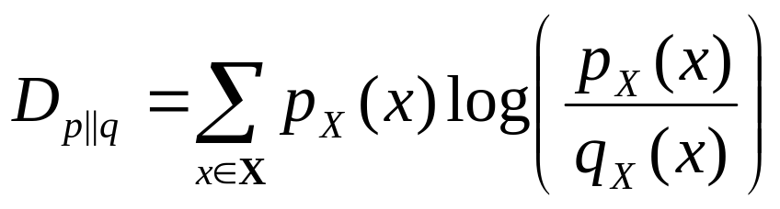
10.5 Kullback-Leibler Divergence
A Lemma(Gray, 1990)
Given any two probability distributions {p_{k}} {q_{k}} for a discrete random variable X, then
Which is satisfied with equality if and only if p_{k} =q_{k} for all k.
  Relative entropy (Kullback-Leibler divergence/distance)
  between two probability mass functions is defined as:
  (for discrete random variables)
The sum is over all possible states of the system. The q_{x} (x) plays the role of a reference measure.
Notes:
K-L散度

Slide 16
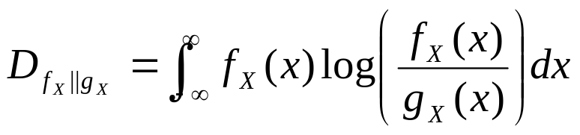
10.5 Kullback-Leibler Divergence
  For continuous random variables, defines
Properties of Kullback-Leibler divergence
  Nonnegative, when f_{x}(x)=g_{x}(x), its zero.
  Invariant with respect to the following changes of the components of vector X:
    Permutation of the order in which the components are arranged
    Amplitude scaling
    Monotonic nonlinear transformation
Notes:
单调线性变换

Slide 17
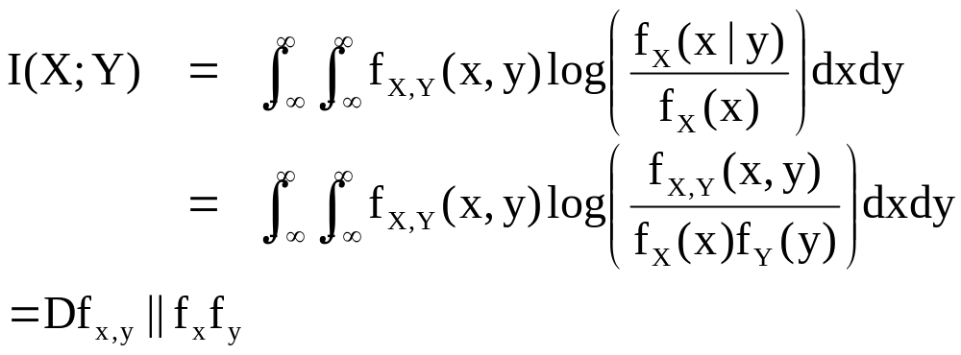
10.5 Kullback-Leibler Divergence
Mutual information revisited in KL divergence
(10.38)
The MI between X and Y is equal to the KL divergence between the joint probability density f_{x,y} and the product of the density functions f_{y} and f_{y}
Notes:
Revisit --重游，再访问

Slide 18
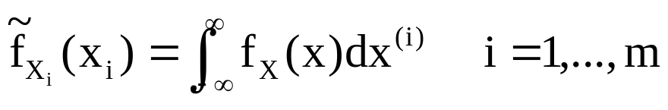
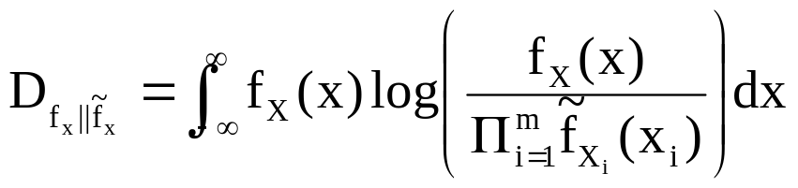
10.5 Kullback-Leibler Divergence
KL divergence between f_{x}(x) and the product of its m marginal probability density functions.
The ith marginal probability density function of element x_{i}
(10.39)
X^{(ii)} is the (m-1) by 1 vector left after removing the ith element from vector x.
(10.40)

Slide 19
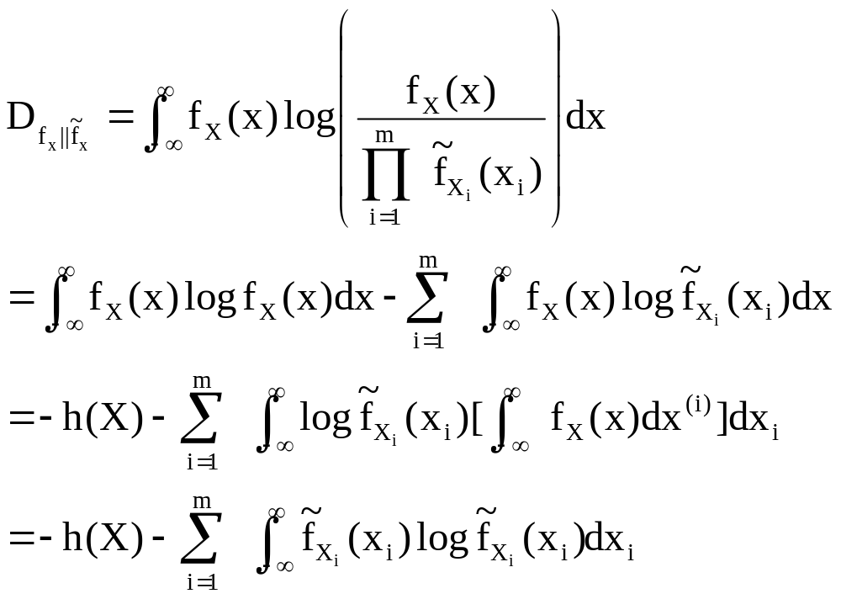
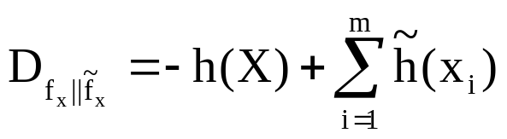
10.5 Kullback-Leibler Divergence
KL divergence between f_{x}(x) and the product of its m marginal probability density functions.

Slide 20
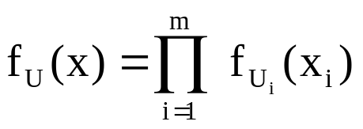
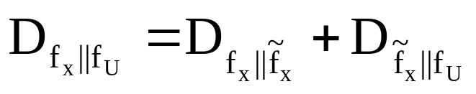
10.5 Kullback-Leibler Divergence
Pythagorean Decomposition
Suppose there is a m-by-1 random vector U consists of independent variable
And there is a m-by-1 random vector X is defined in terms of U by
X=AU
A is a nondiagonal matrix.
The K-L divergence between f_{X}(x) and f_{U}(x) admits

Slide 21
10.1-10.4 Summary
Fundamental Information Theory
  Entropy
    A quantitative measure of information
  Maximum Entropy Principle
    Constrained optimization problem
  Mutual Information
    The amount of uncertainty reduced after some observation
  Kullback-Leibler Divergence
Notes:
The MI between X and Y is equal to the KL divergence between the joint probability density f_{x,y} and the product of the density functions f_{y} and f_{y}

